Slide 1
Purchase and Sales Manager
The management application for the shop’s accounts
By Vimal S

Slide 2
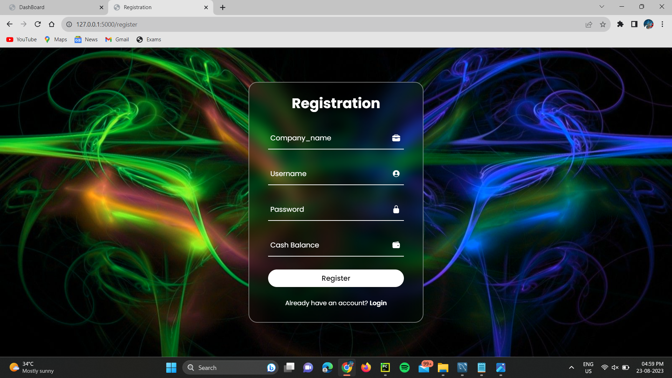
Registration
The new user can register with there company name, password and intial amount of the company that they hold

Slide 3
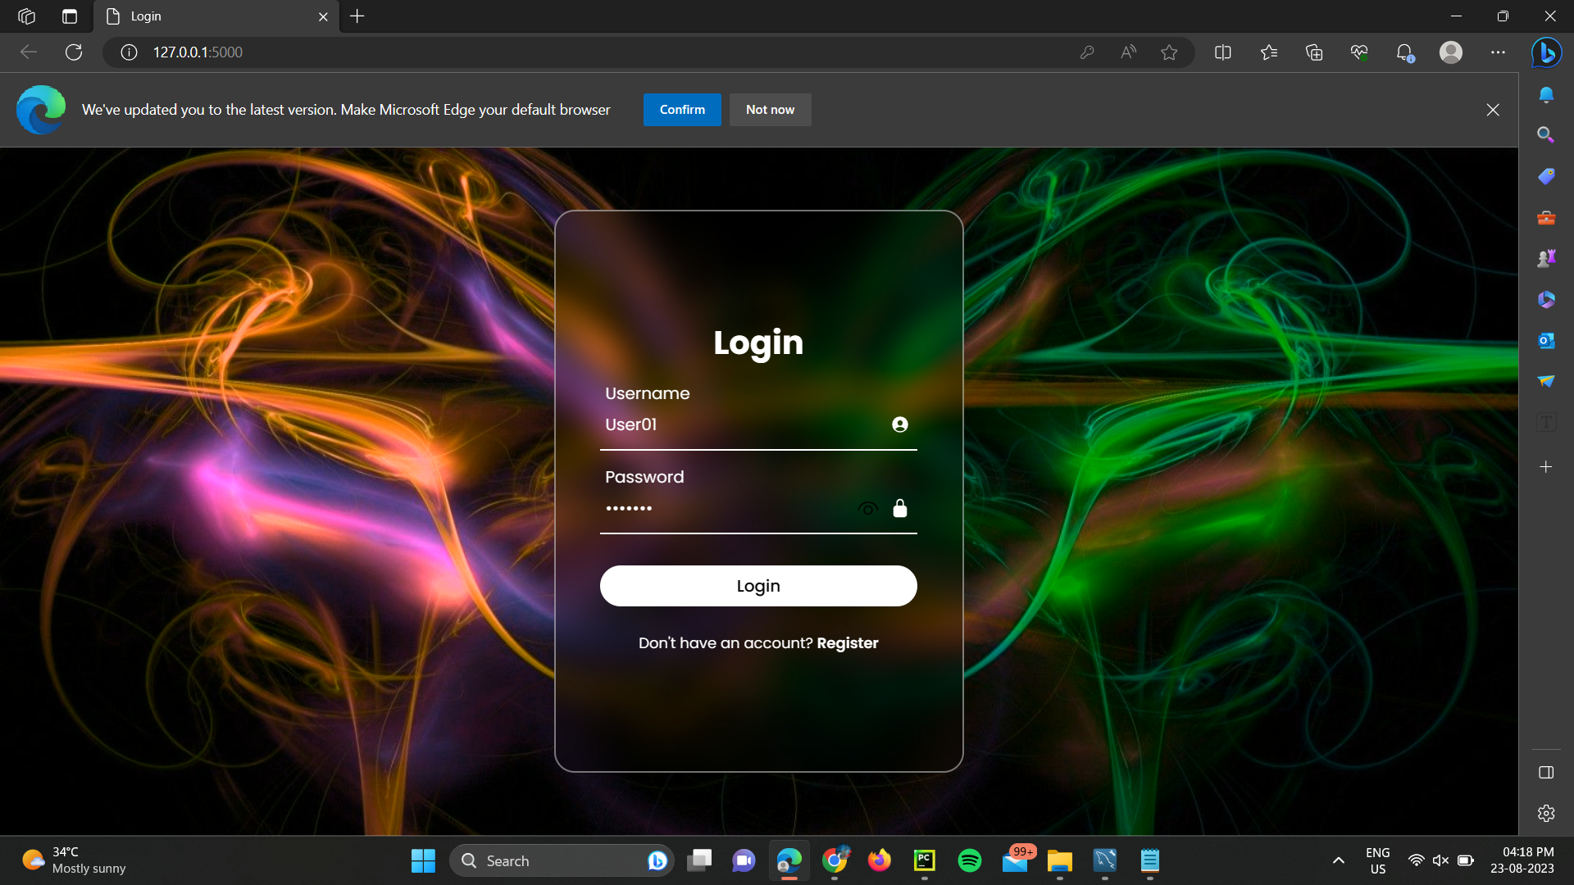
Login
The registered user can login with their credentials

Slide 4
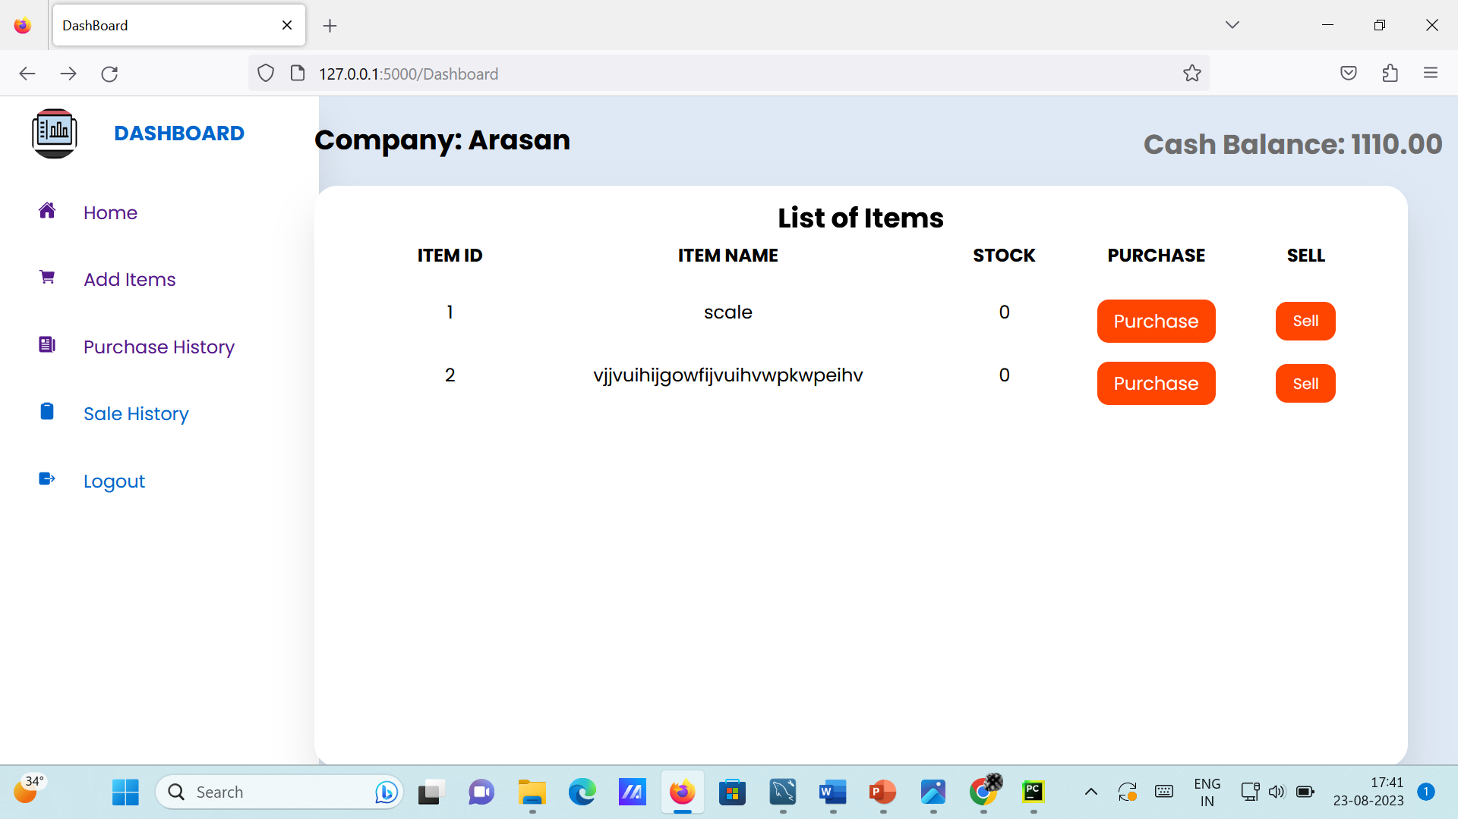
Dashboard
In this dashboard the user can see there name and balance and the list of items in the shop and the stock details and the can enter the purchase and sales details by clicking the appropriate buttons
This dashboard have functionalities of viewing purchase and sales report and can add items to the dashboard

Slide 5
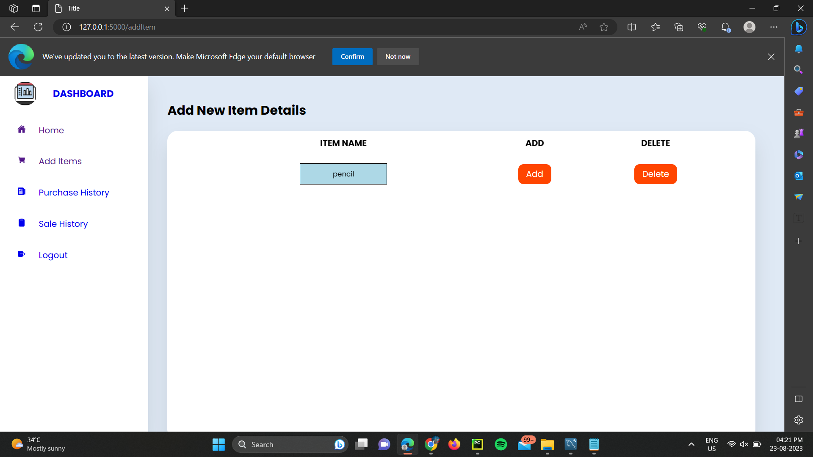
Add Items
The new user can add the item buy clicking the add items icon and enter the item name and the have additional option of deleting the item tooo

Slide 6
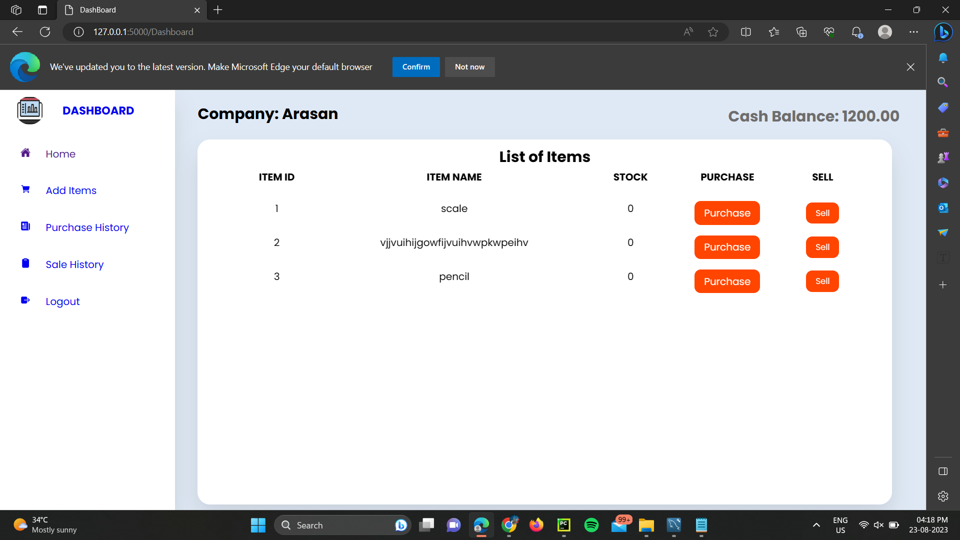
Item Displayed
The added item will in the above step is displayed

Slide 7
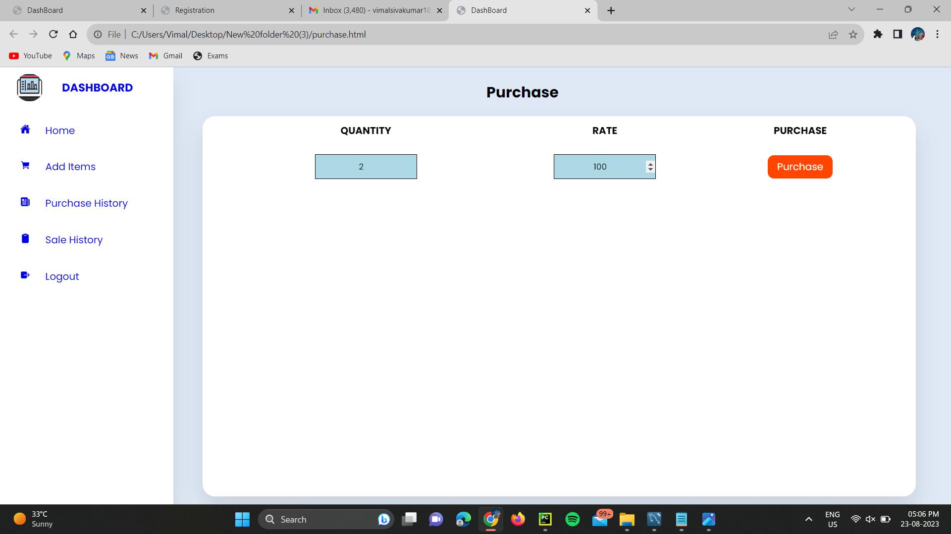
Purchase page
Enter the quantity and rate and click the purchase to buy the item

Slide 8
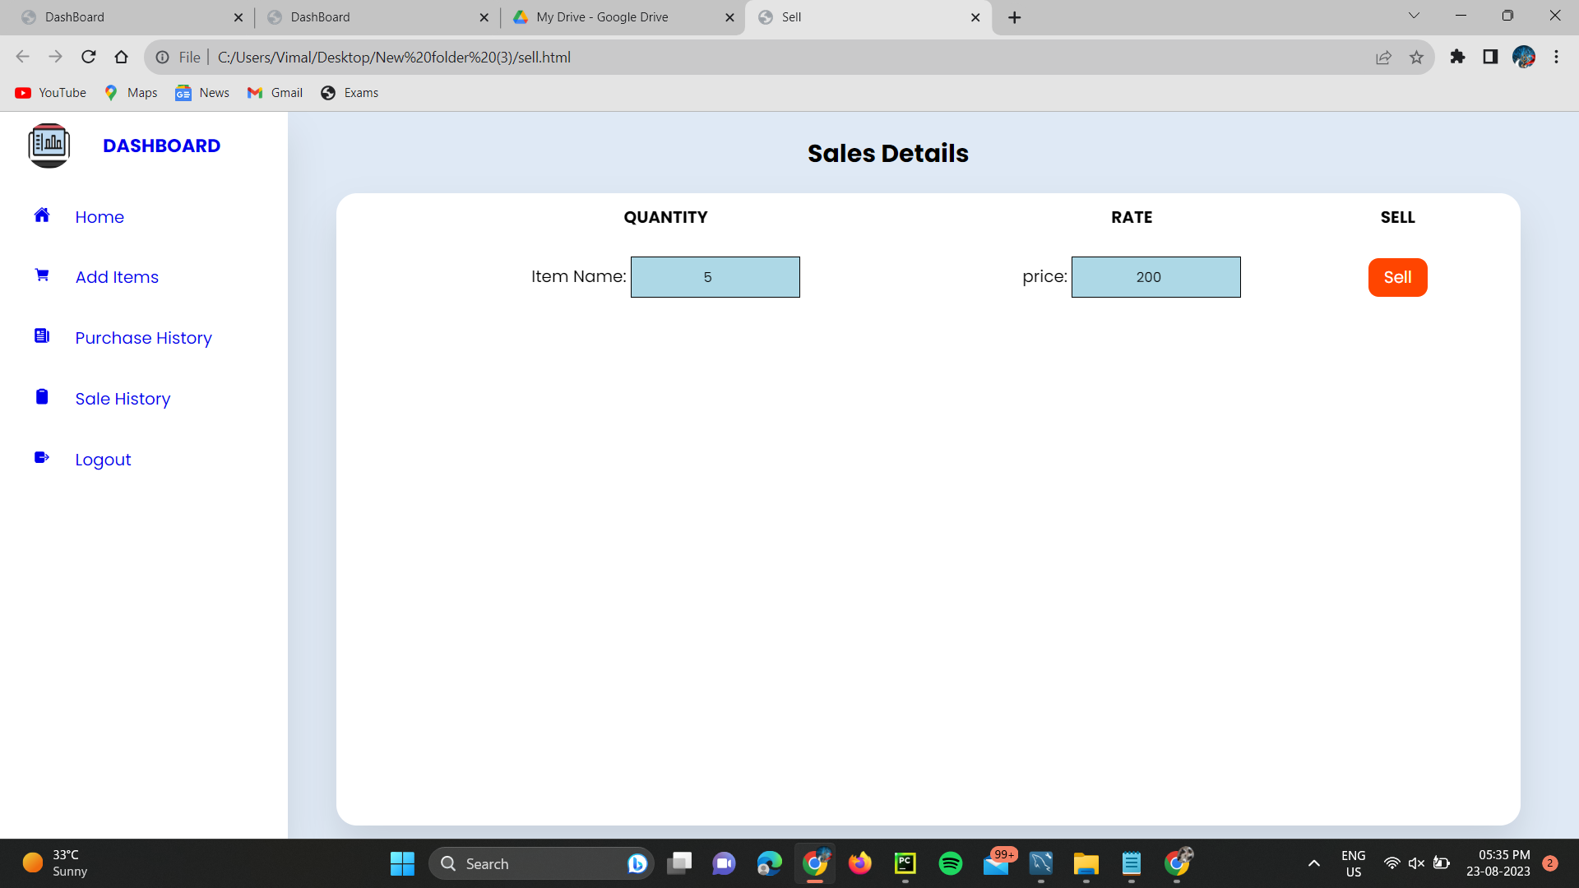
Sales
Enter the quantity and rate and click the sell to sell the item

Slide 9
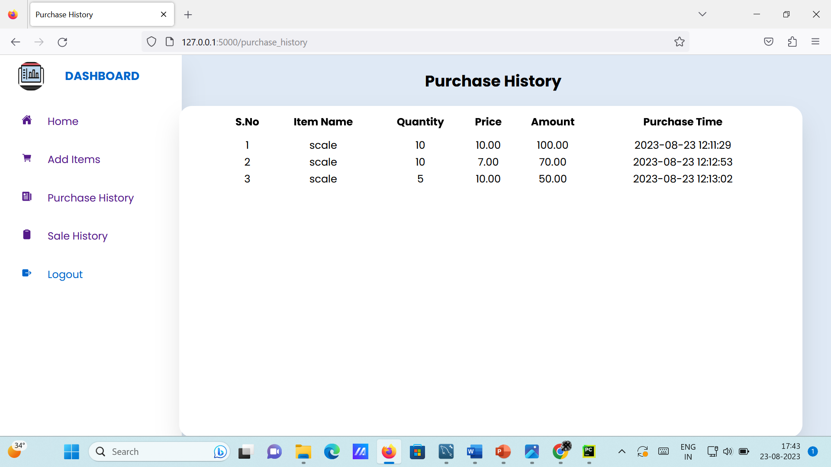
Purchase history
The history of all purchases are displayed here with its corresponding bought price

Slide 10
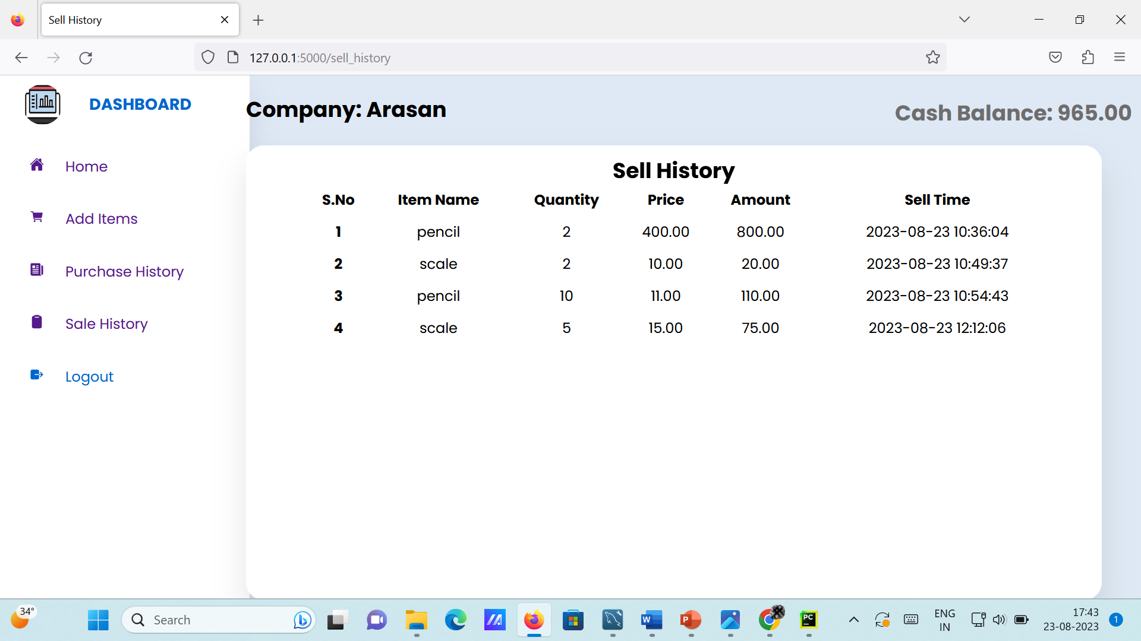
Sales history
The all sales history is displayed with it prise of sold

